Slide 1



Using Nextflow with ARCC University of Wyoming Robert A. Petit III, PhD Timothy Robinson, PhD Daniel Hintz, MS May 15th, 2023

Slide 2

Disclaimer
The views and opinions expressed in today’s workshop are mine and do not necessarily reflect the views or positions of the Wyoming Public Health Laboratory

Slide 3






Outline for today’s workshop
People
Meet some of the people at Wyoming Public Health Laboratory
Nextflow
An introduction into Nextflow and how Nextflow can help streamline complex analyses
nf-core & Use Cases
We’ll explore nf-core and a few Nextflow use cases
Nextflow + Beartooth
We’ll do a demo of Nextflow using a configuration file customized for Beartooth
Ex. Bootstrapping
We’ll walk through an example of how you can use Nextflow to distribute bootstraps across Beartooth
Wrap Up
Time to ask for tips and tricks when using Nextflow on Beartooth and how you might apply it to your research. Then wrap things up.

Slide 4
Interrupt me
Please don’t hesitate to ask questions! There are a few breaks, but if you need to step out, step out!

Slide 5
Overview for today
Introductions
Workflow Management Systems
Nextflow & nf-core
Nextflow config for Beartooth
Distributing bootstrapping operations on Beartooth using Nextflow
Wrap up

Slide 6
People over in Cheyenne
1
Let’s put some faces to WPHL

Slide 7

Yo! 👋
I AM Robert
The bioinformatics scientist for Wyoming Public Health Laboratory

Slide 8




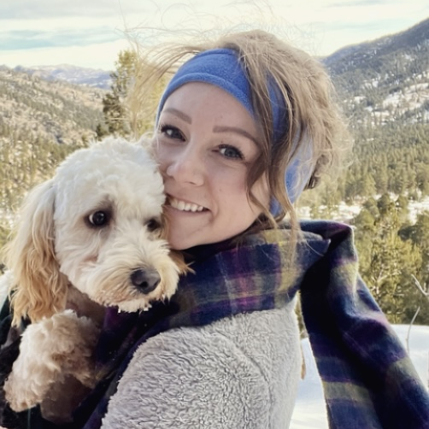
A few others from WPHL
Joseph Reed, PhD Laboratory Administrator
Rob Christensen
Microbiology Lab Administrator
Jim Mildenberger
Microbiology Lab Supervisor
Taylor Fearing
EID & NGS Supervisor
Chayse Rowley EID Scientist

Slide 9

Wyoming Public Health Lab
15-20 people at WPHL
Led nation in % SC2+ cases sequenced
Domestic and International trainings
Strong relationship with State Vet Lab and Ag Labs

Slide 10



Ongoing collaborations between WPHL and UW
Bledar Bisha, PhD
Animal Sciences Department Head
Nic Blouin, PhD
Bioinformatics Core Director Research Scientist
Tim Robinson, PhD
Professor of Statistics
Dan Hintz, MS
MS candidate in Statistics
Interned with WPHL through INBRE

Slide 11
2
Let’s learn about the Nextflow workflow management system

Slide 12
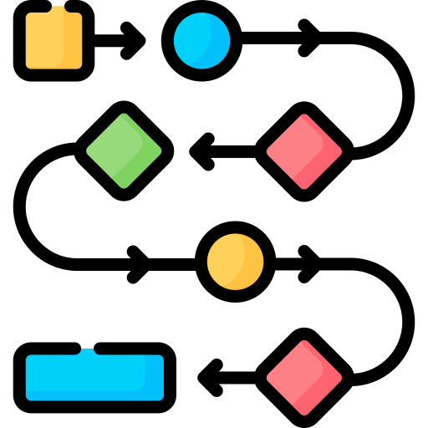
But first…
What is a workflow management system?

Slide 13
Workflow management systems simplify running and scaling of computational workflows on distributed compute environments

Slide 14






Streamline Your Research with Workflow Management Systems (WMS)
Reproducibility
WMSs provide standardized approaches to data analysis, ensuring analysis can be reproduced.
Efficiency
WMSs automate routine processing tasks once handled by the user
Scalability
WMSs can easily scale to large datasets allowing for more ambitious research projects
Portability
WMSs often support many different compute environments for easy deployment
Collaboration
WMSs workflows can easily be shared for others to make use of one another’s analyses
Error Handling
WMSs help to simplify the debugging process through built-in error handlers

Slide 15









What are examples of workflow management systems?

Slide 16
2
Let’s learn about the Nextflow workflow management system

Slide 17
A little about Nextflow
https://www.nextflow.io/
Free and open-source
Written in Groovy, depends on Java
Supported and Maintained by Seqera Labs

Slide 18
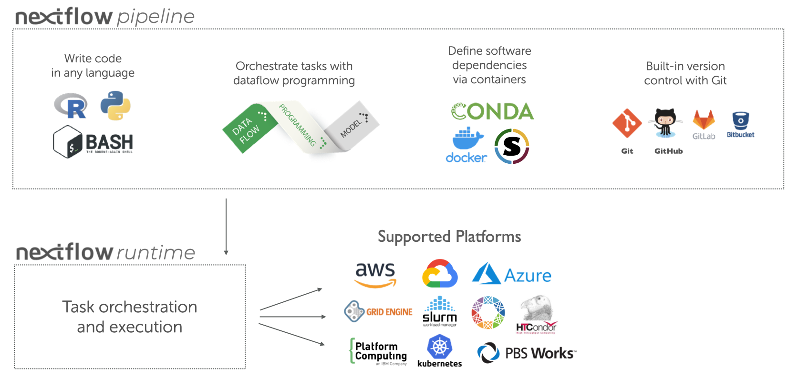
Do more science with Nextflow

Slide 19
Nextflow simplifies running and scaling workflows on clusters by abstracting complexity and integrating scheduling and resource allocation

Slide 20

3
A community effort to collect a curated set of analysis pipelines built using Nextflow.

Slide 21





nf-core delivers fully featured pipelines
Documentation
Extensive documentation covering installation, usage and description of output files ensures that you won't be left in the dark.
CI Testing
Every time a change is made to the pipeline code, nf-core pipelines use continuous-integration testing to ensure that nothing has broken.
Stable Releases
nf-core pipelines use GitHub releases to tag stable versions of the code and software, making pipeline runs totally reproducible.
Packaged Software
Pipeline dependencies are automatically downloaded and handled using Docker, Singularity, Conda or others. No need for any software installations.
Cloud-ready
Pipelines are tested on AWS after every release. You can even browse results live on the website and use outputs for your own benchmarking.
Portable & Reproducible
Pipelines follow best-practices to ensure maximum portability and reproducibility. The large community makes the pipelines exceptionally well tested and easy to run.

Slide 22
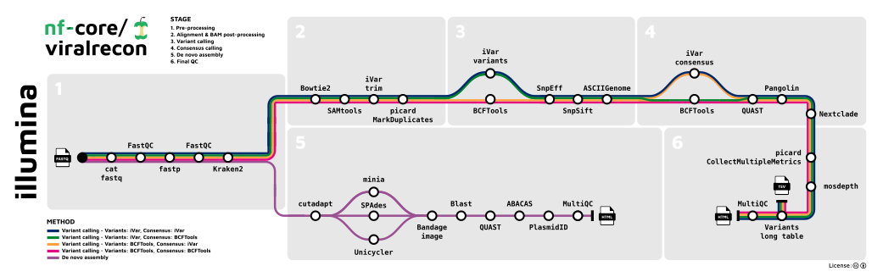
Example pipeline - nf-core/viralrecon
Analysis of viral genomes
Used throughout the world during the COVID-19 pandemic

Slide 23
Nextflow is not just for bioinformatics

Slide 24
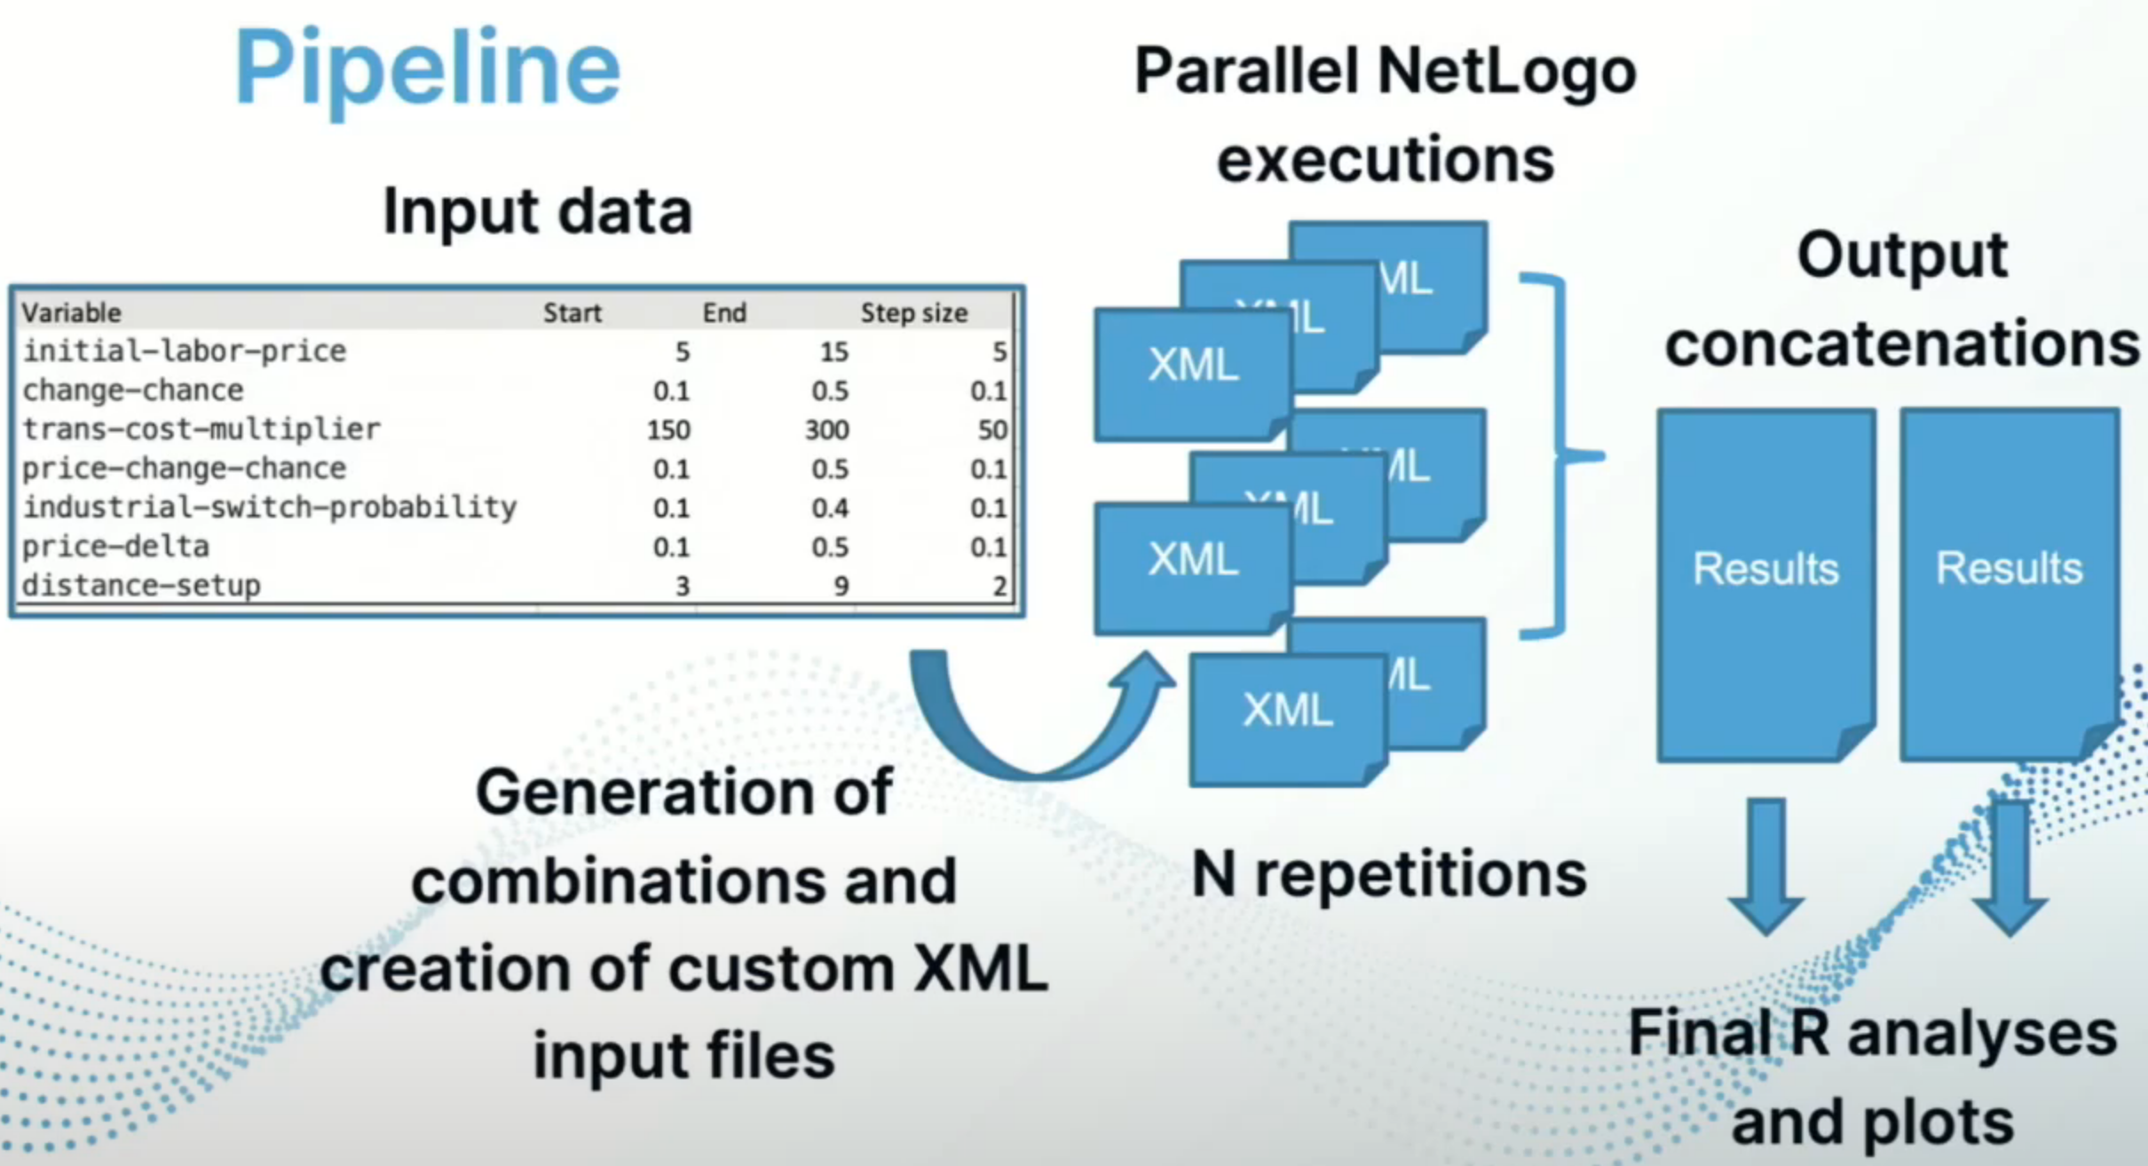
Using Nextflow to model the economics of the industrial revolution
Nicola Visonà, Ph.D. student in quantitative economics
Used Nextflow to scale agent-based modeling
SpinningJenny Workflow, YouTube

Slide 25
Other non-Bioinformatics Use Cases
AI – Stable Diffusion text-to-image
Astronomy – Analysis of images from telescopes
Linguistics – Analyzing digitized Dutch texts (800-present)
Medical – Diffusion MRI image analysis
Statistics - Markov chain Monte Carlo using Stan

Slide 26
Any questions so far?
Nextflow, nf-core, use-cases, etc.

Slide 27
Nextflow config for Beartooth
4

Slide 28
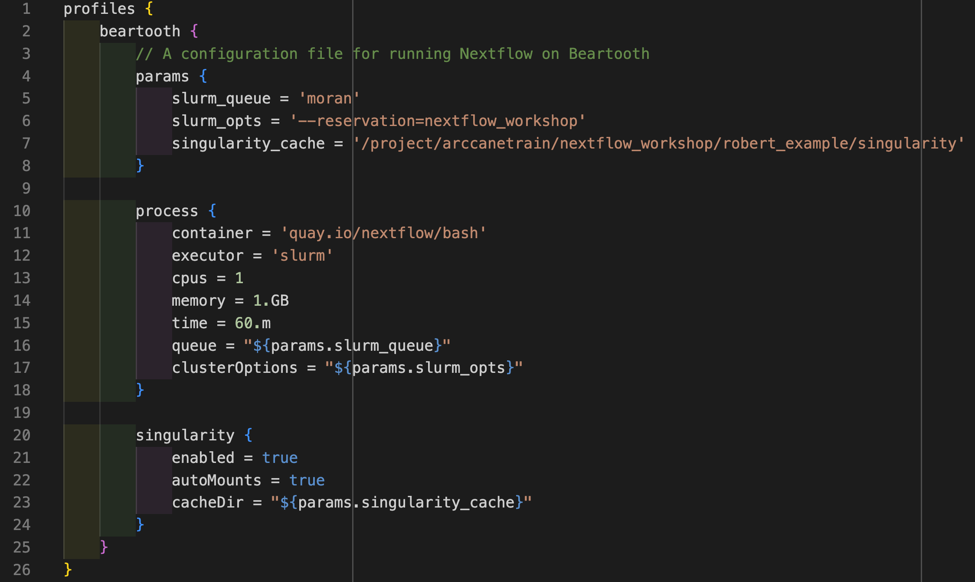
Working Nextflow configuration file for Beartooth

Slide 29
Let’s demo nf-core/viralrecon with this config
5

Slide 30
Ask Me Anything
6
How? What? Where? Anything related to using Nextflow on Beartooth

Slide 31

Break Time!
Let’s take a 10 minute break, eat some snacks, move around, chat, etc…

Slide 32

Tim Robinson- bootstrapping
7
Tim the floors is yours!

Slide 33


Kukupa
A study considered monitoring efforts of the Kukupa, New Zealand’s only native pigeon. Area exposed to intensive pest control. Stations in the Bream Head area selected at random and abundance was recorded at each of 10 stations for a period of 12 years.

Slide 34
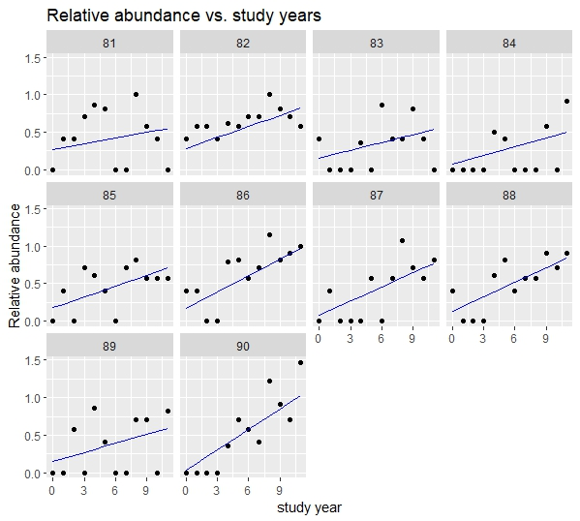
Data

Slide 35
Model
Relative abundance at individual sites likely varies due to habitat differences (elevation, forage quality, predator abundance, etc.)
Change in relative abundance over time could also vary between sites
Random coefficient models are common models for hierarchical data

Slide 36
Interpretations of Model Terms

Slide 37

Bootstrap Inference
Inference in hierarchical models relies on asymptotic (i.e., large sample sizes) standard errors.
Bootstrap inference does not depend on asymptotic standard errors.
Bootstrapping can also be done when we are interested in making an inference on functions of parameters (ex., have most abundant locations [ex., 90th percentile] increased/decreased over time?)
Bootstrapping involves re-sampling from our existing data or from probability distributions thought to generate our data

Slide 38
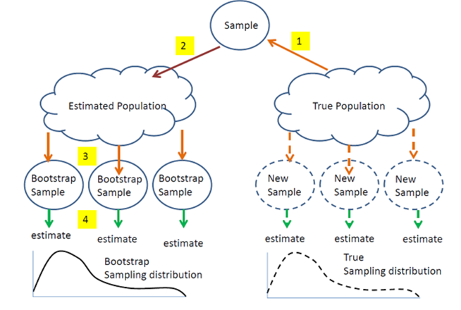

Slide 39
Bootstrap Algorithm
Let B be the number of bootstrap samples to be drawn (ex. 1000)
from the original dataset:
1. Generate a bootstrap sample by resampling from the data and/or from
the estimated model.
2. Obtain the estimates for all parameters of the model for the bootstrap
sample.
3. Repeat steps 1 and 2, B times to obtain the bootstrap distribution
of the parameter estimates (or function of parameter estimates).
* A 95% bootstrap confidence interval can be constructed by calculating the 2.5th and 97.5th percentile of the bootstrap distribution

Slide 40
Using lmer() from the lme4 R package
# in below, x = lmer model object, FUN = function you want bootstrapped, nsim=B
# bootstrap and save fixed effect estimates
#bootMer() is a workhorse function generating all 1000 simulations on a single node
b_fixpar <- bootMer(x=m4,FUN=fixef,nsim=1000)
boot_fixed <- data.frame(b_fixpar$t)
slope_bounds <- boot.ci(b_fixpar,type="perc",index=2)
slope_lower <- slope_bounds$percent[4]
slope_upper <- slope_bounds$percent[5]
plot(density(boot_fixed$Scale_Yr),main="Parametric Bootstrap Distribution of Slope")
abline(v=slope_lower,col="red")
abline(v=slope_upper,col="red")

Slide 41
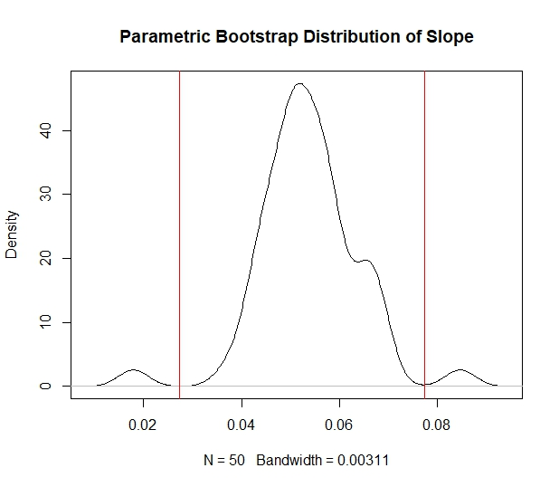
Bootstrap Distribution - Interval on Slope
> slope_bounds
BOOTSTRAP CONFIDENCE INTERVAL CALCULATIONS
Based on 500 bootstrap replicates
CALL :
boot.ci(boot.out = b_fixpar, type = "perc", index = 2)
Intervals :
Level Percentile
95% ( 0.0273, 0.0776 )

Slide 42
Dan Hintz – Nextflow Bootstrap
8
Take it away Dan!

Slide 43


G’day!
I’M Dan
M.S. Candidate in Statistics
University of Wyoming
dhintz1@uwyo.edu

Slide 44
When might I want to Run a Bootstrap In parallel?
Have complicated hierarchical or mixed model
When will my code finish executing?
Notes:
Imagine you are running a job on Rstudio or in python and you rana. Bootstrap and if you choose a very small amount of simulations it runs in a couple of minutes but the moment you run it with a allot of simulations it takes a very long time, maybe your not sure how long and after running for two days you start to question if this is the best way to be doing this

Slide 45
Overview of Our Pipeline Code
1. Set up
2. Run bootstrap across B partitions
3. Merge and draw distribution
4. Specify process execution order

Slide 46
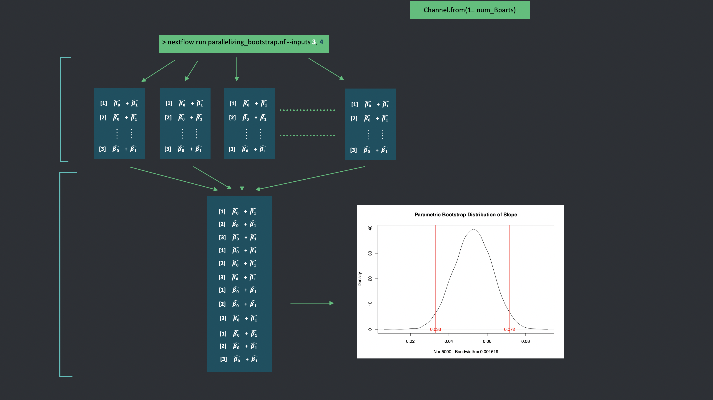
The Pipeline
1) Distribute bootstraps
2) Merge & plot distribution of slopes
Notes:
Mention that the dots signify there could be more rows or more partitions

Slide 47
Overview of our pipeline code
1. Set up
2. Run bootstrap across B partitions
3. Merge and Draw distribution
4. Specify process execution order

Slide 48
Plan
Run code to see end goal we will get to
Step back and explain everything in chunks and work back to our final goal
Notes:
Show merged matrix
Show pdf file

Slide 49

A recipe for connecting various coding languages to perform a job
\\ nextflow code
Shell:
’’’
# bash code
Rscript foo.R
’’’
Rscript foo.R
python foo.py
julia foo.jl
bash foo.sh
\\ more nextflow code

Slide 50
Files
parallelizing_bootstrap.nf
boot.r
bootCI_plot.r
Kukupa.csv

Slide 51
How does everything fit together
How do get variables, scripts, files, data, etc., get passed between:
the command line
Nextflow
R

Slide 52
How Do We Capture Command Line Arguments
Command line -> nextflow
> nextflow run test.nf --inputs 3,4
```{nextflow}
values_list = params.inputs.tokenize(',')
```
Command line -> R
> Rscript !{rpath} !{merged_matrix}
```{r}
args = commandArgs(trailingOnly = TRUE)
output <- readLines(as.character(args[1]))
```
#nfCapture.nf
```{nextflow}
nextflow.enable.dsl=2
values = params.foo
println(values)
```
> nextflow run nfCapture.nf --foo hello world
N E X T F L O W ~ version 22.10.4
Launching `nfCapture.nf` [Random_name]
hello
# foo.r
```{r}
args = commandArgs(trailingOnly = TRUE)
args
args[1]
```
> Rscript foo.r 1 2 3
[1] "1" "2" "3"
[1] "1"

Slide 53
Capturing Command Line Arguments
“How to parse command-line arguments”
“How to read command-line arguments in a script”
“Capturing command-line arguments”
“Processing command-line arguments in a script”
```{r}
args <-
commandArgs(
trailingOnly=TRUE
)
print(args)
```
```{python}
import sys
args = sys.argv
print(args)
```
```{julia}
args = ARGS
println(args)
```
```{bash}
#!/bin/bash
args="$@"
echo "$args”
```

Slide 54
1. Set Up
Read in files from relative paths
Assertion: make nextflow crash if no inputs provided
Capture arguments from command line
Clean arguments and set as variables
Specify channel

Slide 55
2. process bootstrap {}
Define inputs
Define outputs
Create metadata
Execute R script

Slide 56
3. process merge_matrices {}
Define inputs
Define outputs
Remove all headers after the first matrix
Plot distribution of our slope
If merged_matrices is an input, where in the code did we actually merge the matrices?

Slide 57
4. workflow {}
Bootstrap then merge
Specify order of arguments ingested by our processes
merge_matrices(bootstrap.out.outputfile.collectFile(name: 'merged_matrix.txt')

Slide 58
Something To Look Out For!

Slide 59
Interaction of processes , channels and workflows
Order matters!
params.rbootpath = file("./boot.r")
params.rplotterpath = file("./bootCI_plot.r")
params.csvpath = file("./Kukupa.csv")
num_Betas = values_list[0].toInteger()
num_Bparts = values_list[1].toInteger()
Bparts_channel = Channel.from(1..num_Bparts)
process bootstrap {
input:
path rpath
path csvpath
val Betas
val Bpart
// not printing all of bootstrap
}
workflow {
bootstrap(params.rbootpath,params.csvpath,num_Betas,Bparts_channel)
}
Notes:
How does nextflow know that rpath corresponds to boot.r? Because the order in which inputs were specified math the order in which there are called inside

Slide 60
Interaction of processes , channels and workflows
Order matters!
params.rbootpath = file("./boot.r")
params.rplotterpath = file("./bootCI_plot.r")
params.csvpath = file("./Kukupa.csv")
num_Betas = values_list[0].toInteger()
num_Bparts = values_list[1].toInteger()
Bparts_channel = Channel.from(1..num_Bparts)
process bootstrap {
input:
path rpath
path csvpath
val Betas
val Bpart
// not printing all of bootstrap
}
workflow {
bootstrap(params.rbootpath,params.csvpath,num_Betas,Bparts_channel)
}
Notes:
How does nextflow know that rpath corresponds to boot.r? Because the order in which inputs were specified math the order in which there are called inside

Slide 61
Interaction of processes , channels and workflows
Order matters!
params.rbootpath = file("./boot.r")
params.rplotterpath = file("./bootCI_plot.r")
params.csvpath = file("./Kukupa.csv")
num_Betas = values_list[0].toInteger()
num_Bparts = values_list[1].toInteger()
Bparts_channel = Channel.from(1..num_Bparts)
process bootstrap {
input:
path rpath
path csvpath
val Betas
val Bpart
// not printing all of bootstrap
}
workflow {
bootstrap(params.rbootpath,params.csvpath,num_Betas,Bparts_channel)
}
Notes:
How does nextflow know that rpath corresponds to boot.r? Because the order in which inputs were specified math the order in which there are called inside

Slide 62

Interaction of processes , channels and workflows
Order matters!
params.rbootpath = file("./boot.r")
params.rplotterpath = file("./bootCI_plot.r")
params.csvpath = file("./Kukupa.csv")
num_Betas = values_list[0].toInteger()
num_Bparts = values_list[1].toInteger()
Bparts_channel = Channel.from(1..num_Bparts)
process bootstrap {
input:
path rpath
path csvpath
val Betas
val Bpart
// not printing all of bootstrap
}
workflow {
bootstrap(params.rbootpath,params.csvpath,num_Betas,Bparts_channel)
}
Shouldn’t this be num_Bparts?
Notes:
How does nextflow know that rpath corresponds to boot.r? Because the order in which inputs were specified math the order in which there are called inside

Slide 63
Interaction of processes , channels and workflows
Order matters!
params.rbootpath = file("./boot.r")
params.rplotterpath = file("./bootCI_plot.r")
params.csvpath = file("./Kukupa.csv")
num_Betas = values_list[0].toInteger()
num_Bparts = values_list[1].toInteger()
Bparts_channel = Channel.from(1..num_Bparts)
process bootstrap {
input:
path rpath
path csvpath
val Betas
val Bpart
// not printing all of bootstrap
}
workflow {
bootstrap(params.rbootpath,params.csvpath,num_Betas,Bparts_channel)
}
Notes:
How does nextflow know that rpath corresponds to boot.r? Because the order in which inputs were specified math the order in which there are called inside

Slide 64
Let’s run the code

Slide 65
Nextflow’s Work Directory
> ls –ltr work/
-- alphanumerical hash of length 2
-- alphanumerical hash of length 30
--PROCESS OUTPUT

Slide 66
How do we know that our process is computing in parallel?
ls -ltr file/
> ls -ltr work/
drwxr-sr-x 6 dhintz1 arccanetrain 4.0K May 13 14:01 tmp
drwxr-sr-x 4 dhintz1 arccanetrain 4.0K May 13 14:01 3c
drwxr-sr-x 3 dhintz1 arccanetrain 4.0K May 13 14:01 ad
drwxr-sr-x 3 dhintz1 arccanetrain 4.0K May 13 14:01 9c
> ls -ltr work/9c # then tab completion the rest of the way
> ls -ltr work/9c/c32a611e8259976aed3e6bd34d46ba
> ls -ltr work/94/c32a611e8259976aed3e6bd34d46ba/metadata.1.txt
> Cat work/94/c32a611e8259976aed3e6bd34d46ba/metadata.1.txt
Sat May 13 14:01:49 MDT 2023
Bpart 1, Betas 3
Sat May 13 14:01:50 MDT 2023

Slide 67
Nextflow’s Hidden Work Files
> ls –ltra work/
> ls –ltra work/aa/4avv8v7rvse457rbscrvrt/
drwxr-xr-x 3 dhintz1 dhintz1 4.0K May 12 11:41 ..
-rw-r--r-- 1 dhintz1 dhintz1 3.1K May 12 11:41 .command.run
-rw-r--r-- 1 dhintz1 dhintz1 164 May 12 11:41 .command.sh
-rw-r--r-- 1 dhintz1 dhintz1 0 May 12 11:41 .command.begin
-rw-r--r-- 1 dhintz1 dhintz1 0 May 12 11:41 .command.out
-rw-r--r-- 1 dhintz1 dhintz1 33 May 12 11:41 .command.log
-rw-r--r-- 1 dhintz1 dhintz1 33 May 12 11:41 .command.err
-rw-r--r-- 1 dhintz1 dhintz1 104 May 12 11:41 output.1.txt
drwxr-xr-x 2 dhintz1 dhintz1 4.0K May 12 11:41 .
-rw-r--r-- 1 dhintz1 dhintz1 1 May 12 11:41 .exitcode

Slide 68
.command
.command.sh the command executed in bash for each process
.command.run returns information about the environment set up
.command.begin marker to indicate process started
.command.out standard output (stdout) generated by a process
.command.log standard output (stdout) and standard error (stderr)
.command.err standard error (stderr)
.command.exitcode integer value representing completion status

Slide 69
Let’s look at our plot again on South Pass
Abundance of Kukupa is increasing on average across sites
Now you can use parallelizing_bootstrap.nf as a template for your own work!

Slide 70
Extras

Slide 71
Conda (for cluster)
Am I in a conda environment right now?
conda info --envs
Creating a conda environment
conda create -p /project/arccanetrain/nextflow_workshop/nextflow_env
Activating a conda environment
conda activate /project/arccanetrain/nextflow_workshop/nextflow_env
Installing packages into a conda environment
conda install -c r r-lme4

Slide 72
Conda (for local machine))
Creating a conda environment with nextflow installed
conda create -n nextflow_env -c conda-forge -c bioconda nextflow
What is the path to my new conda environment
conda info --envs
Activating a conda environment
conda activate /user/foo/bar/nextflow_env
Installing packages into a conda environment
conda install -c r r-lme4

Slide 73
Conda (for local machine)
Creating a conda environment with nextflow
What is the path to my new conda environment
conda create -n nextflow -c conda-forge -c bioconda nextflow

Slide 74
Parellisizing across cores
How many cores do I have?
sysctl -n hw.ncpu # number of logical cores
sysctl -n hw.physicalcpu # number of physical cores

Slide 75
Running an Interactive Session
salloc --account=yourprojectname --nodes=# --ntasks=# --cpus-per-task=# --time=##:##:#
salloc --account=arccanetrain --nodes=1 --tasks=16 --cpus-per-task=1 --reservation=nextflow_workshop --time=4:00:00

Slide 76
nextflow.config
profiles {beartooth{}} Defines a profile named beartooth that configures settings
process.executor: Specifies the executor to use Slurm for running the processes.
process.clusterOptions: : Specifies additional options to be passed to the cluster submission command. Here, it is set to "-A arccanetrain" which means that the processes will be submitted to the Slurm cluster with the account name arccanetrain.
process.time: Specifies the maximum time a process is allowed to run
The following settings are commented out (disabled) with the /** ... **/ syntax
process.cpus: Specifies the number of CPUs required for each process
process.memory: Specifies the amount of memory required for each process.
process.queue: Specifies the Slurm partition (queue) to submit the processes to.

Slide 77
Loading modules into ARCC
Say I want to see what modules I need to load for nextflow
module spider nextflow
How do I load a module after running spider
module load module/##.##.#

Slide 78
Debugging .r, .py objects from the command line
❯ cat << EOF | Rscript -
load("/full_Path/workshop/my_output/Rdata/R_obj_merge.Rdata")
print(ls())
EOF
❯ cat << EOF | python3
import statistics
x = [1, 2, 3, 4, 5]
print(statistics.mean(x))
EOF

Slide 79
boot.r
Captures command line arguments betas and kukapa.csv with commandArgs()
Reads in kukapa.csv
Creates mixed model object m5 with lme4::lmer()
runs bootstrap with lme4::bootMer()
Outputs the bootstrap matrix

Slide 80
bootCI_plot.r
Captures command line arguments using commandArgs()
Read in .txt file
Massages data format to a data.frame
Set bounds using quantile()
plots distribution

Slide 81
Wrap Up
9
Let’s conclude this and get out of here!

Slide 82

That’s a wrap!
Thank you for attending and please feel free to reach out if you think WPHL can help!

Slide 83
Resources to help with your Nextflow Adventure
https://www.nextflow.io/
Documentation
Nextflow Docs
nf-core Docs
Training
Nextflow Training
Nextflow Workshop
Seqera Labs
Software Carpentries
Pipelines & Modules
80 nf-core Pipelines
900 nf-core Modules
Bactopia - Bacterial Genomics
Awesome Nextflow
Community
Nextflow Slack
nf-core Slack

